Slide 1
Data Types
Presented By:
Ayran, Joshua
Ferdes, Justin Louise
Paruginog, John Ulysess

Slide 2
What is Union
Type?

Slide 3
Definition
A union is a special data type available in C that allows to store different data types in the same memory location. You can define a union with many members, but only one member can contain a value at any given time. Unions provide an efficient way of using the same memory location for multiple-purpose.

Slide 4
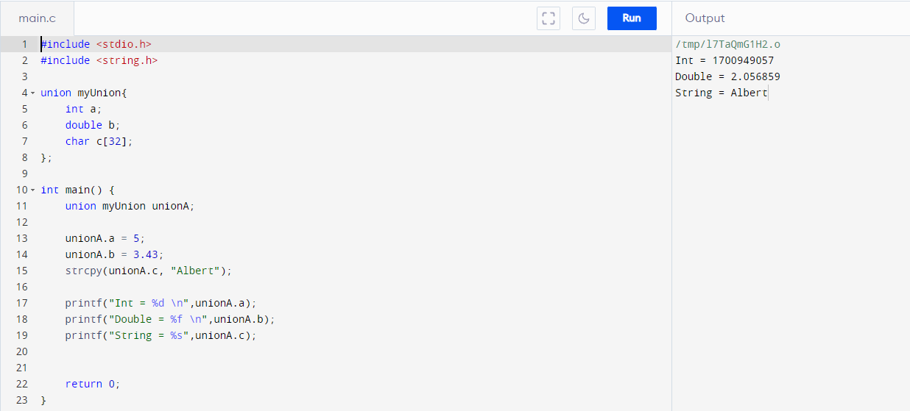
Example 1 of union in C

Slide 5
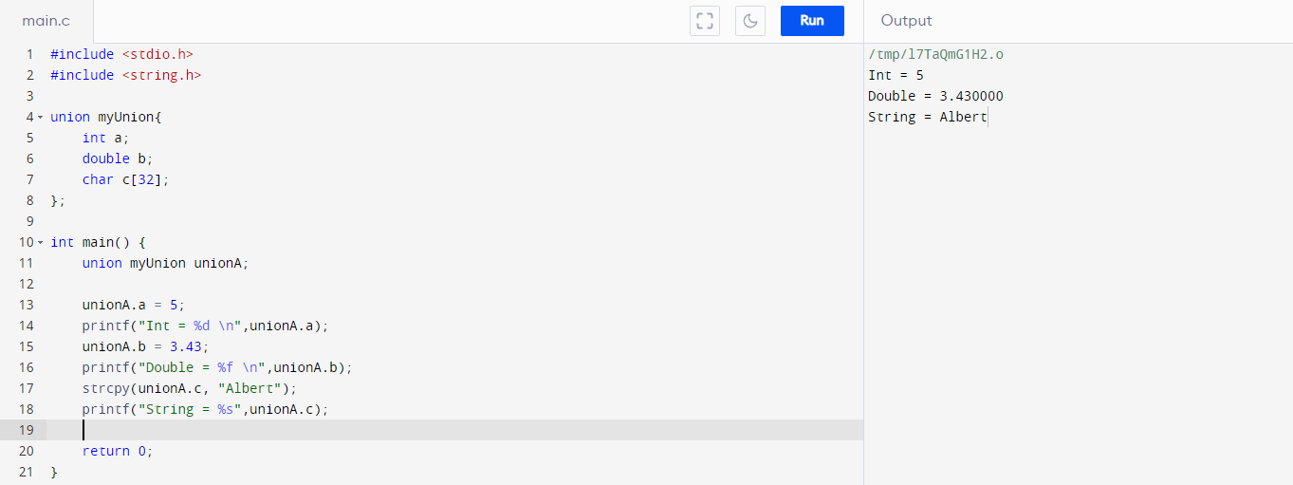
Example 2 of Union

Slide 6
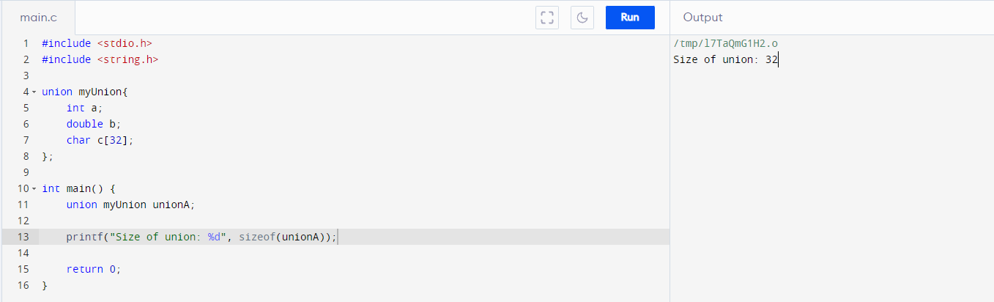
If all of them are stored in same memory space, what is the memory size of the union?
The size of the union is defined by the largest member of the union

Slide 7
Why use Union?
To save memory
Allow data members which are mutually exclusive to share the same memory

Slide 8
Pointers
Memory
Address | Value
1000 | 1010 0101
1001 | 1111 1001
1002 | 1100 0011
1003 | 0011 1100
1004 | 0001 1000

Slide 9
What is a pointer?
A pointer is a variable that stores the memory address of another variable as its value.
A pointer variable points to a data type (like int) of the same type, and is created with the * operator.

Slide 10
Pointer
Address | Value
1000 | 1010 0101
1001 | 1000
1002 | 1100 0011
1003 | 0011 1100
1004 | 0001 1000
int x;
int * pX = &x

Slide 11
Declaring and initializing pointer
int x ;
int * pX = &x;

Slide 12
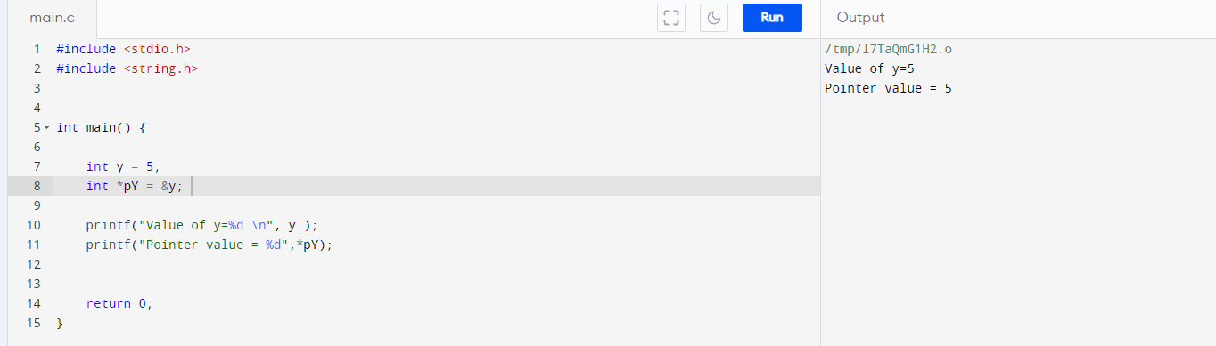
Example of pointer

Slide 13
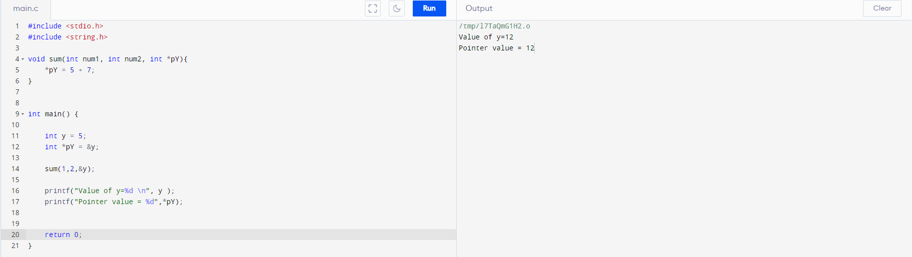
Example of pointers

Slide 14
Reference
A reference variable is an alias, that is, another name for an already existing variable. Once a reference is initialized with a variable, either the variable name or the reference name may be used to refer to the variable.

Slide 15
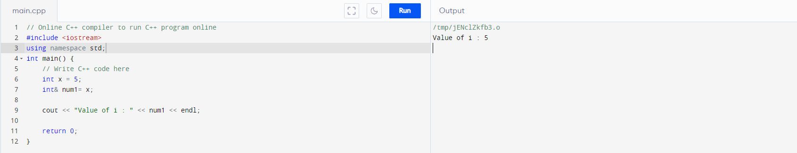
Example of reference

Slide 16
Difference of Pointer and Reference
Reference
It is necessary to initialize it with a value during declaration.
It cannot be NULL.
It does not need to be dereferenced and can be used simply by name.
Arithmetic operations can not be performed on it.
It cannot be re-assigned to any other variable after its initialization.
Pointer
It is not necessary to initialize it with a value during declaration.
It can be assigned a NULL value
It must be dereferenced with a * to access the variable’s value.
Arithmetic operations can be performed on it.
After declaration, it can be re-assigned to any other variable of the same type.

Slide 17
Heap Management

Slide 18
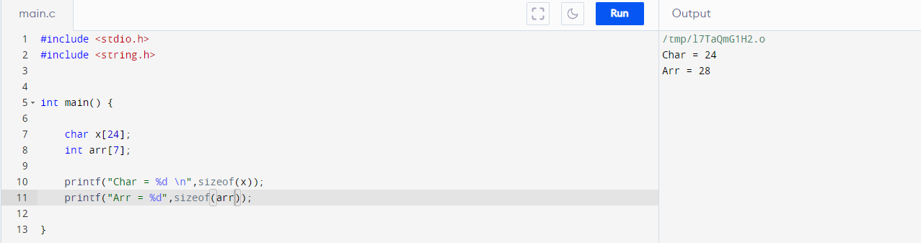
Static Memory Allocation
Memory Allocated during Compile time is called static memory.
The memory allocated is fixed and cannot be increased or decreased during run time.
Example:

Slide 19
Problem of Static memory allocation
If you are allocating memory for an array during compile time then you have to fix the size at the time of declaration. Size is fixed and user cannot increase or decrease the size of the array at run time
If the values stored by the user in the array at run time is less than the size specified then there will be wastage of memory
If the values stored by the user in the array at run time is more than the specified then the program may crash or misbehave.

Slide 20
Dynamic Memory Allocation
The process of allocating memory at the time of execution is called dynamic memory allocation

Slide 21
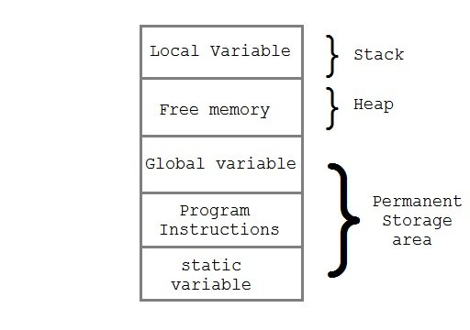
Heap
Heap is used in dynamic memory allocation
Memory manager allocates and deallocates memory

Slide 22
Memory Manager Function
Memory manager have two basic function
Allocation
Deallocation

Slide 23
Properties of memory manager
Space Efficiency- Minimize the heap space required by a program
Program Efficiency- Better use of program to run faster using less memory
Low overhead- Allocation and Deallocation should be efficient

